Slide 1

Practice Your Programming with Katas
Session 7: Show me the money!

Slide 2

Week 7: http://eca-katas/session7
Before accepting a credit card number, it’s sensible to work out if it could be valid!
Write a function that verifies if a given CC number (string) looks valid
Working from right to left, double every other figure starting with the 2nd
Add together the figures for any number now greater than or equal to 10
Add all the resulting numbers together (doubled and not)
If the result is exactly divisible by 10, the CC number is a valid one.
Your function should return True if the number is valid, False otherwise

Slide 3
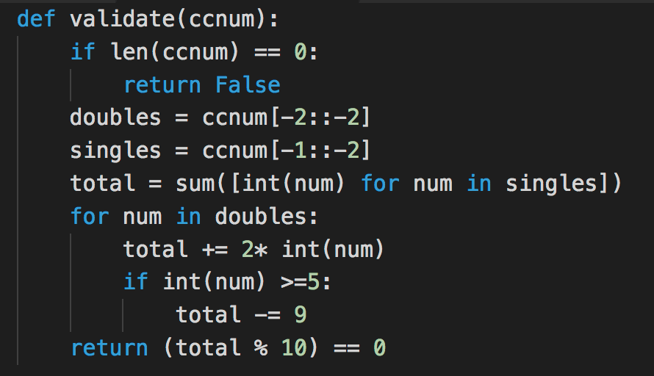
List slices are our Friends!

Slide 4
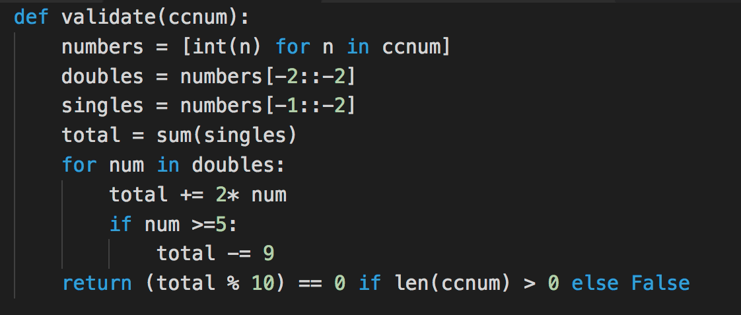
Transform to int() before we start

Slide 5
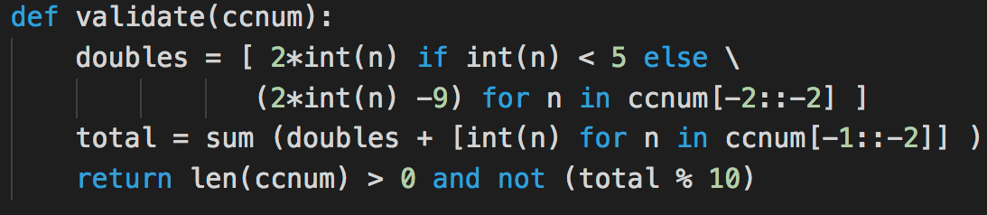
Collapsing things down

Slide 6
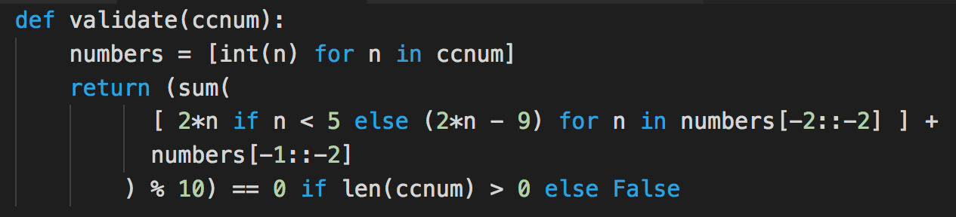
Collapse even further

Slide 7
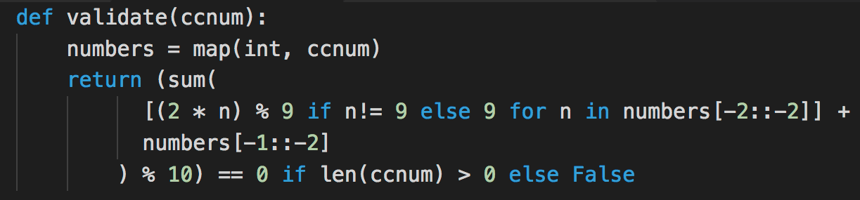
Alternative to the first list comprehension

Slide 8
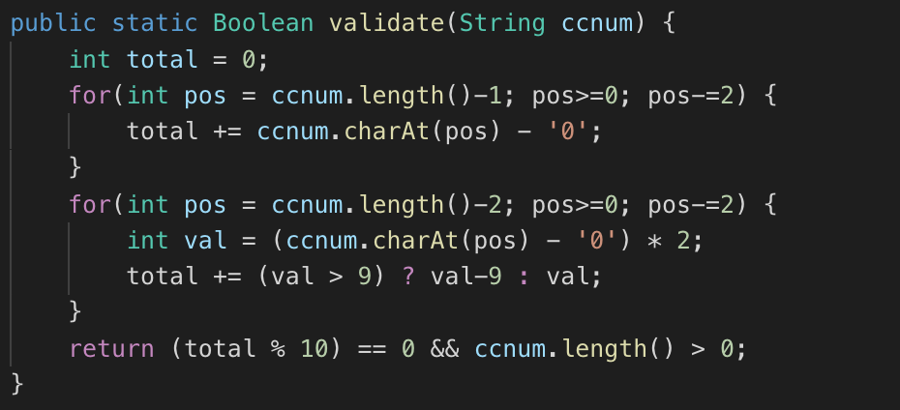
Looping over the list twice

Slide 9
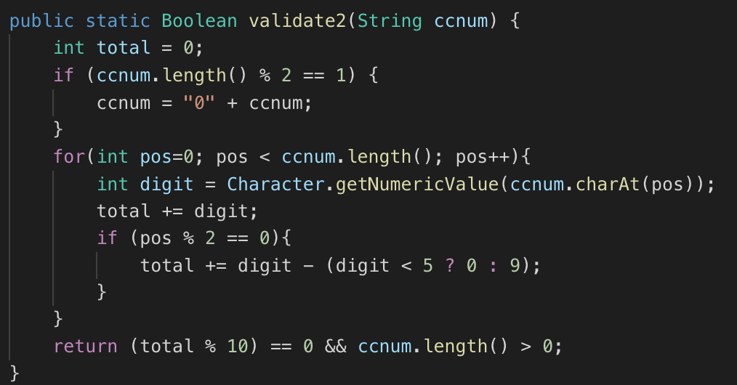
Lightbulb moment 💡

Slide 10
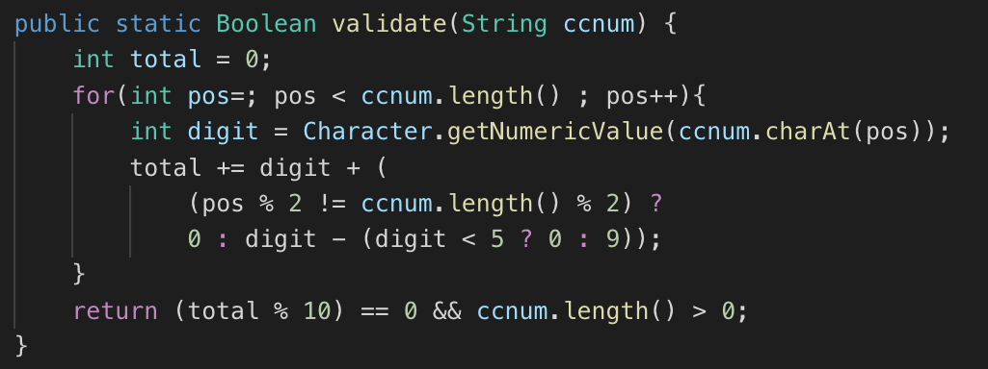
Single pass, no padding
There’s that pesky lesser-spotted nested ternary operator again…

Slide 11
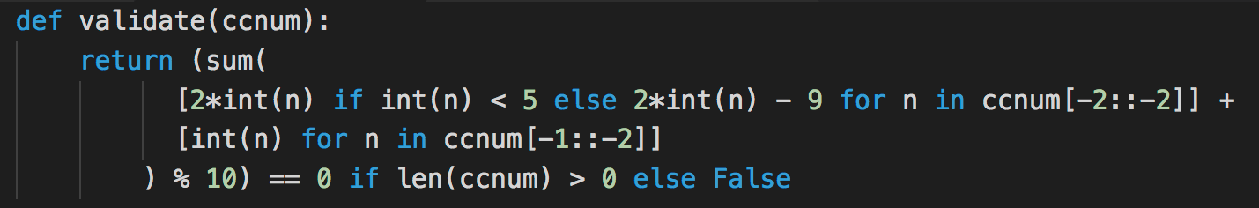
Reductio ad absurbum

Slide 12
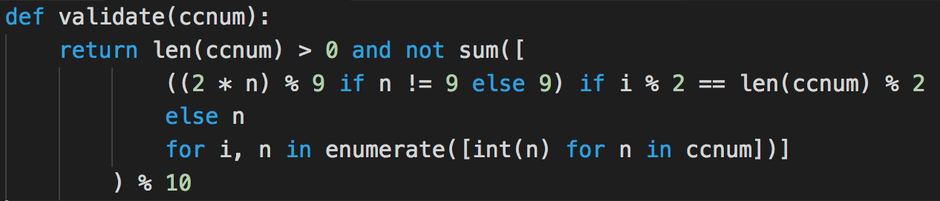
What about enumerate() ?

Slide 13
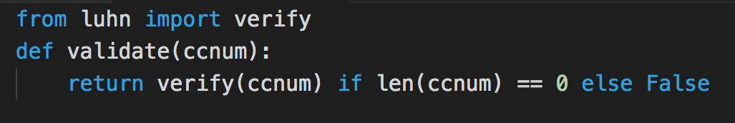
pip install luhn is cheating!
“Good writers borrow from other writers. Great writers steal from them outright.”
- Aaron Sorkin (stealing from T.S. Eliot!)

